Slide 1
Source Control

Slide 2
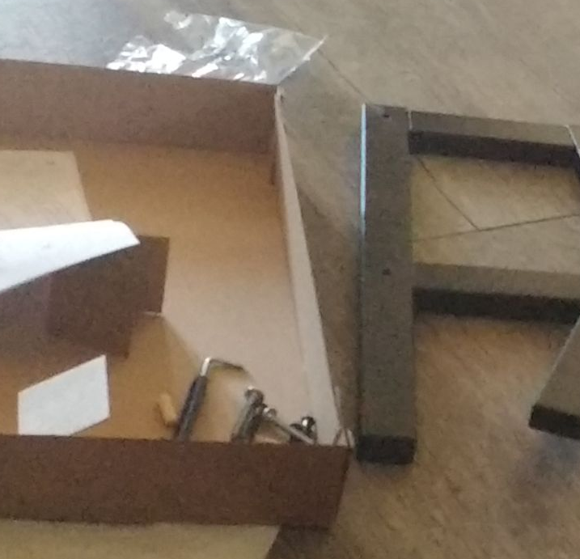


Dealing With Different Versions
Project at 1 p.m.
Project at 2 p.m.
Project at 3 a.m.
Notes:
Writing programs is an incremental process.
When you start your process, you have a lot of ideas, which are raw materials. as you go along, you start fitting these together. You check if your project runs. It’s not perfect, so you keep making changes. Sometimes, those changes can actually make the project worse, or there’s a bug and you can’t even open your project.
You may want to revert to a previous version.

Slide 3
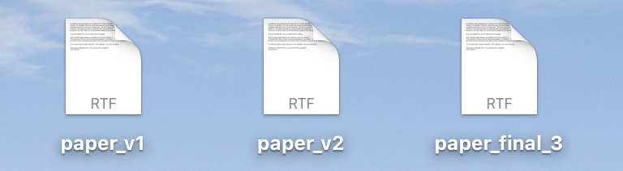
Informal Version Control
Idea: manually save versions of your project
Names can get long or use hard-to-read dates.
You may forget to store versions often enough.
It can be hard to collaborate unless you understand the same system.
Notes:
If you’ve ever had problems like this, you’ve probably tried to save different versions of your project.
A lot of people have tried systems like this: paper, paper V1, paper V2, paper final.
But for big projects, this starts to get clunky and error prone.
Names can get long. You may forget to save often enough. It can be hard to work with others, especially if they don't understand the system that you're using. Or maybe they're used to using some different method of naming their own files.
What if you had to work on a data science team with 20 people - how would you name everything?

Slide 4
What Is Source Control?
Source control management/version control: a system for organizing different versions of a project under development
Notes:
For these situations, we need a more structured solution. We need something called source control or version control.
This is a system for organizing different versions of a project.
The project could be a book. It could be slides.
It could really be almost anything that you're working on. Of course, in our case, we mainly want to keep track of different versions of the programs that we're writing.

Slide 5
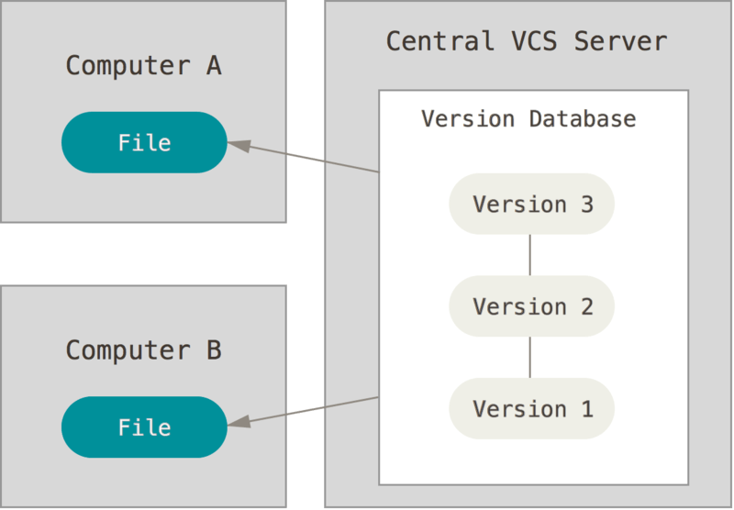
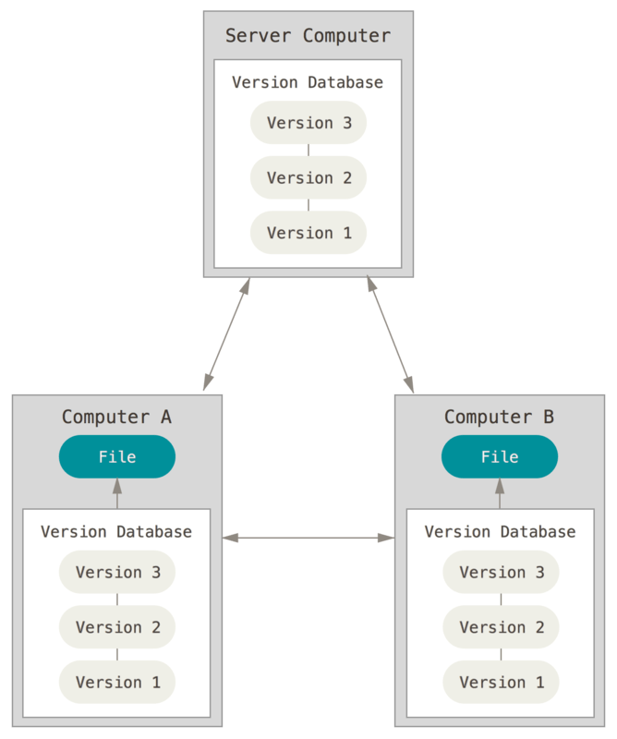
Types of Version Control
Centralized
Distributed
Notes:
Centralized
All project files stored in one central location
People can check out, work on files & check back in when done
Examples: Subversion CVS
Distributed
Every person working on the project has a full copy of every version of every file.
Relatively robust because there isn’t a single point of failure.
Examples: Git, Google Drive

Slide 6

Git
Git is the most common version control system used by data scientists and software developers
Commit: a snapshot of your project files
First commit
HEAD
Notes:
The first thing to know about git, is that it doesn’t try to remember the changes you make directly.
Instead, it stores what we call commits.
a commit is a snapshot of your project - imagine taking a picture of your files, exactly as they are at one point in time, and storing that.
Imagine you start a project with one file, and you take your first snapshot. That’s a commit, and there’s a pointer labeled HEAD that tells us that this is the commit we’re going to add on to.

Slide 7
Git
Git is the most common version control system used by data scientists and software developers
Commit: a snapshot of your project files
First commit
Commit fh453…
HEAD
Notes:
You add another file to the project and you take another snapshot.
The new commit remembers which commit it came from - that’s called the parent commit.

Slide 8
Git
Git is the most common version control system used by data scientists and software developers
Commit: a snapshot of your project files
First commit
Commit fh453…
Commit hr543…
HEAD
Notes:
You add a third commit, and now we have an entire history of commits.
You can always go back and checkout one of the previous commits if you have to.
Next let’s see what the process looks like on the command line.

Slide 9
Source Control

